Slide 1
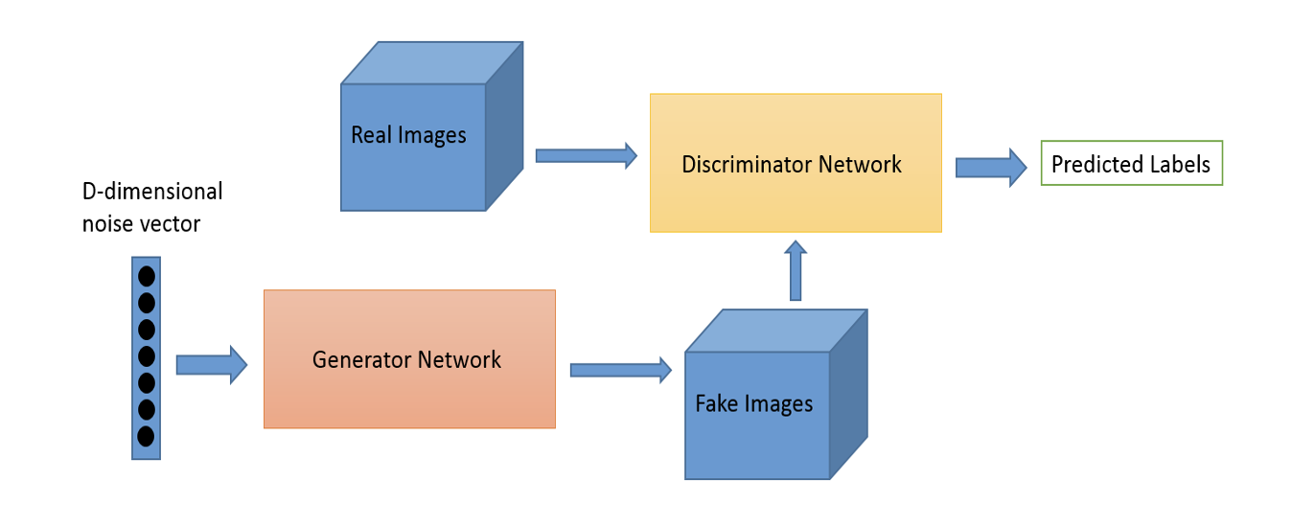
GANs

Slide 2
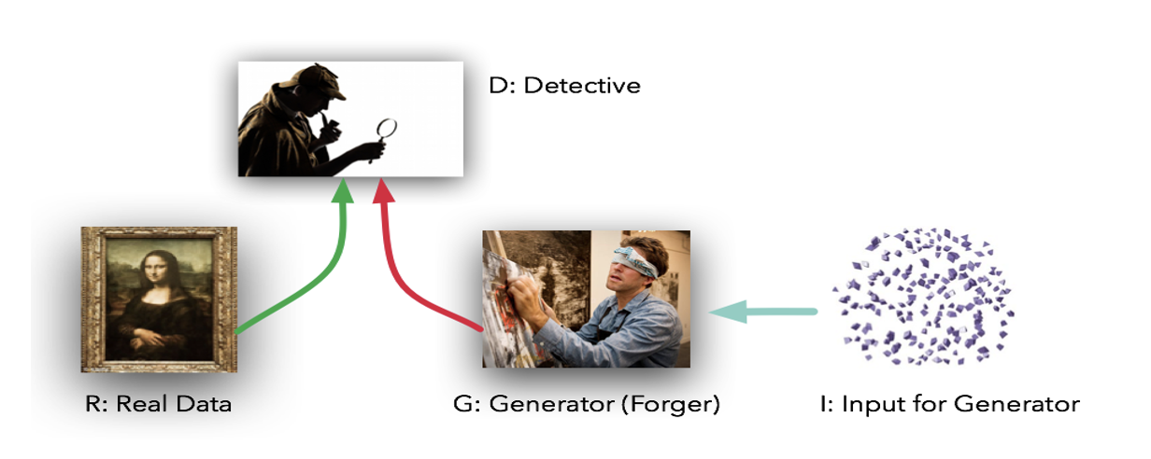

Slide 3
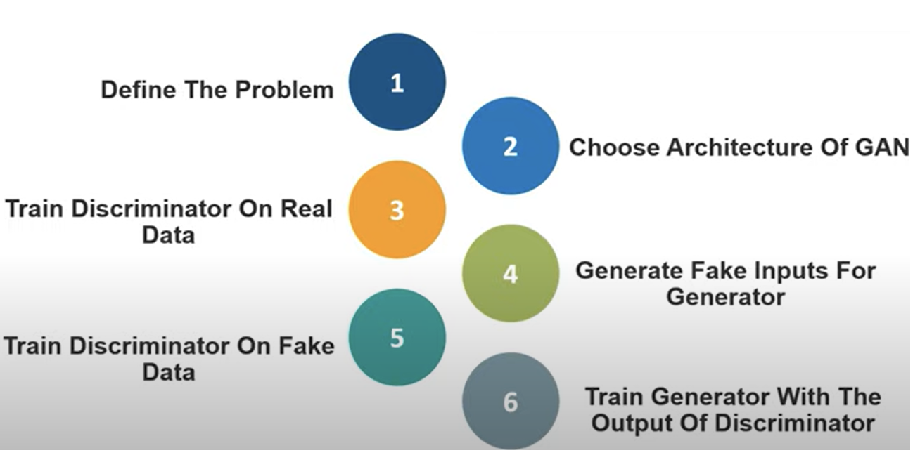

Slide 4
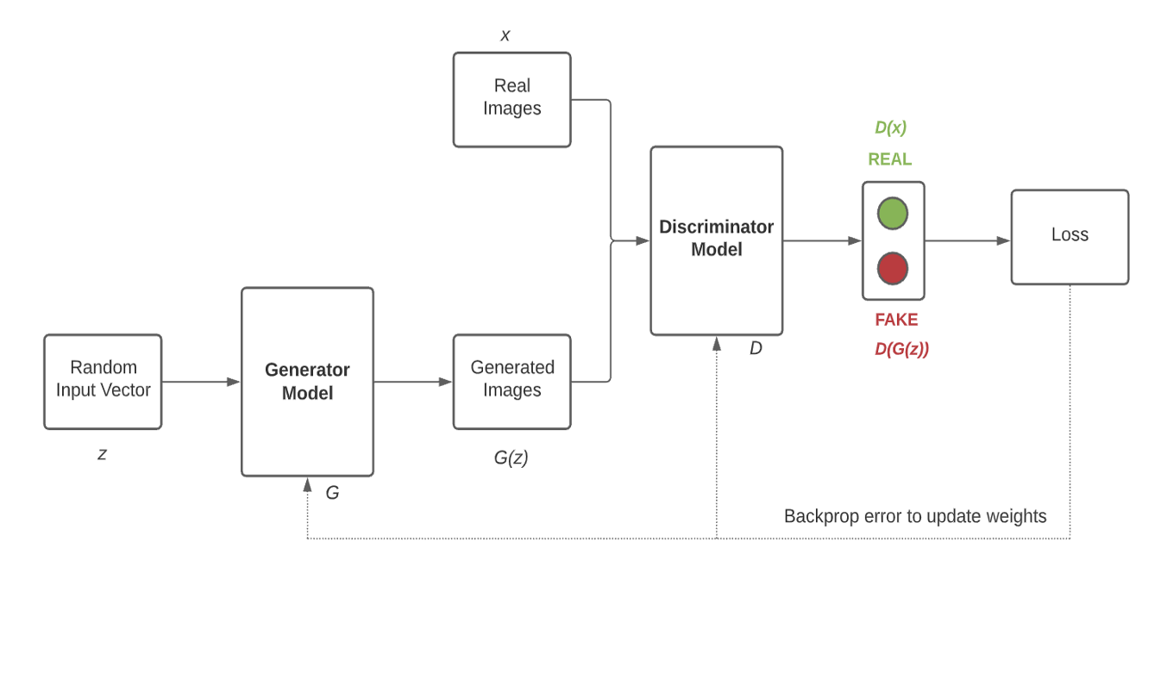
WORKING OF GAN

Slide 5
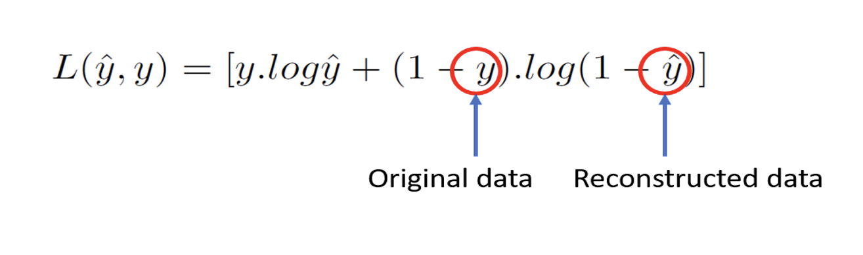
DERIVATION OF LOSS FUNCTION FROM binary cross-entropy loss

Slide 6
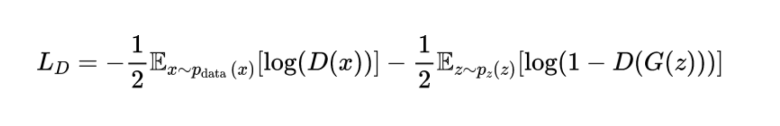
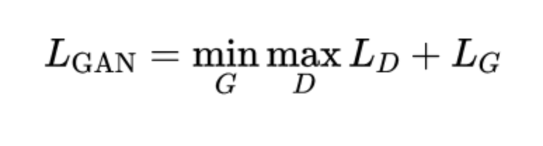
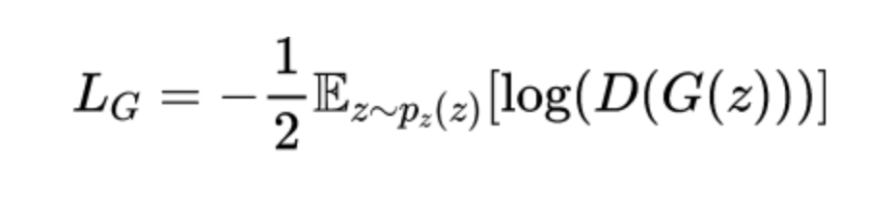
DISCRIMINATOR LOSS
GENERATOR LOSS
+

Slide 7
THE DIFFERENT TYPES OF GENERATIVE ADVERSARIAL NETWORKS (GANS) ARE:
Vanilla GAN
Conditional Gan (CGAN)
Deep Convolutional GAN (DCGAN)
CycleGAN
Generative Adversarial Text to Image Synthesis
Style GAN
Super Resolution GAN (SRGAN)
3D GAN
SpecGAN
WaveGAN
Stack GAN etc.

Slide 8
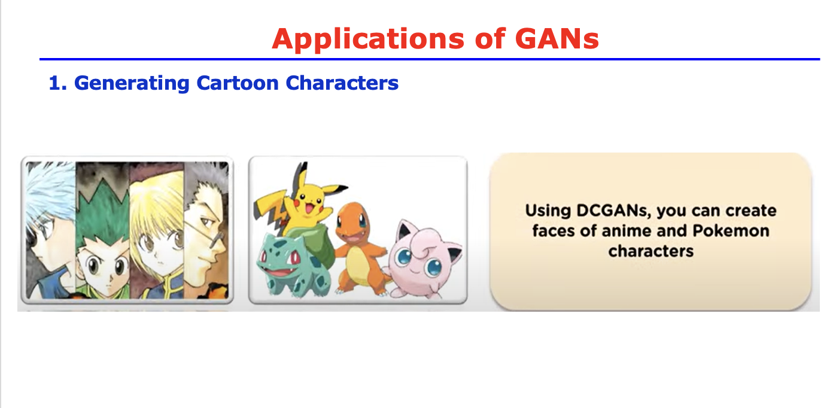

Slide 9
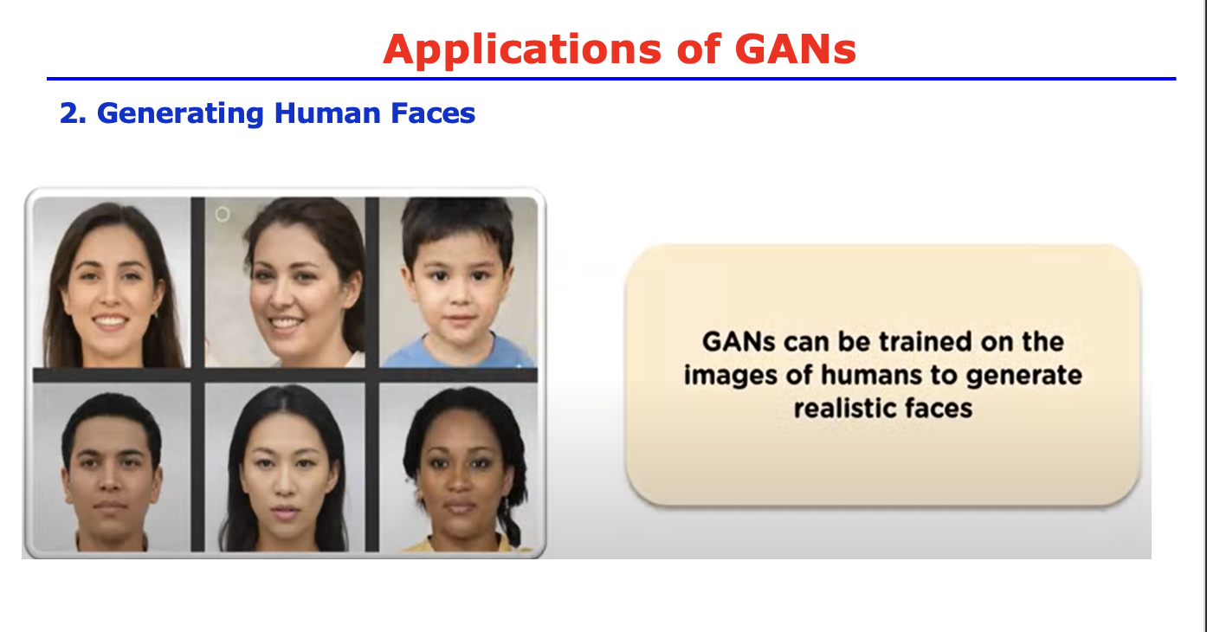

Slide 10
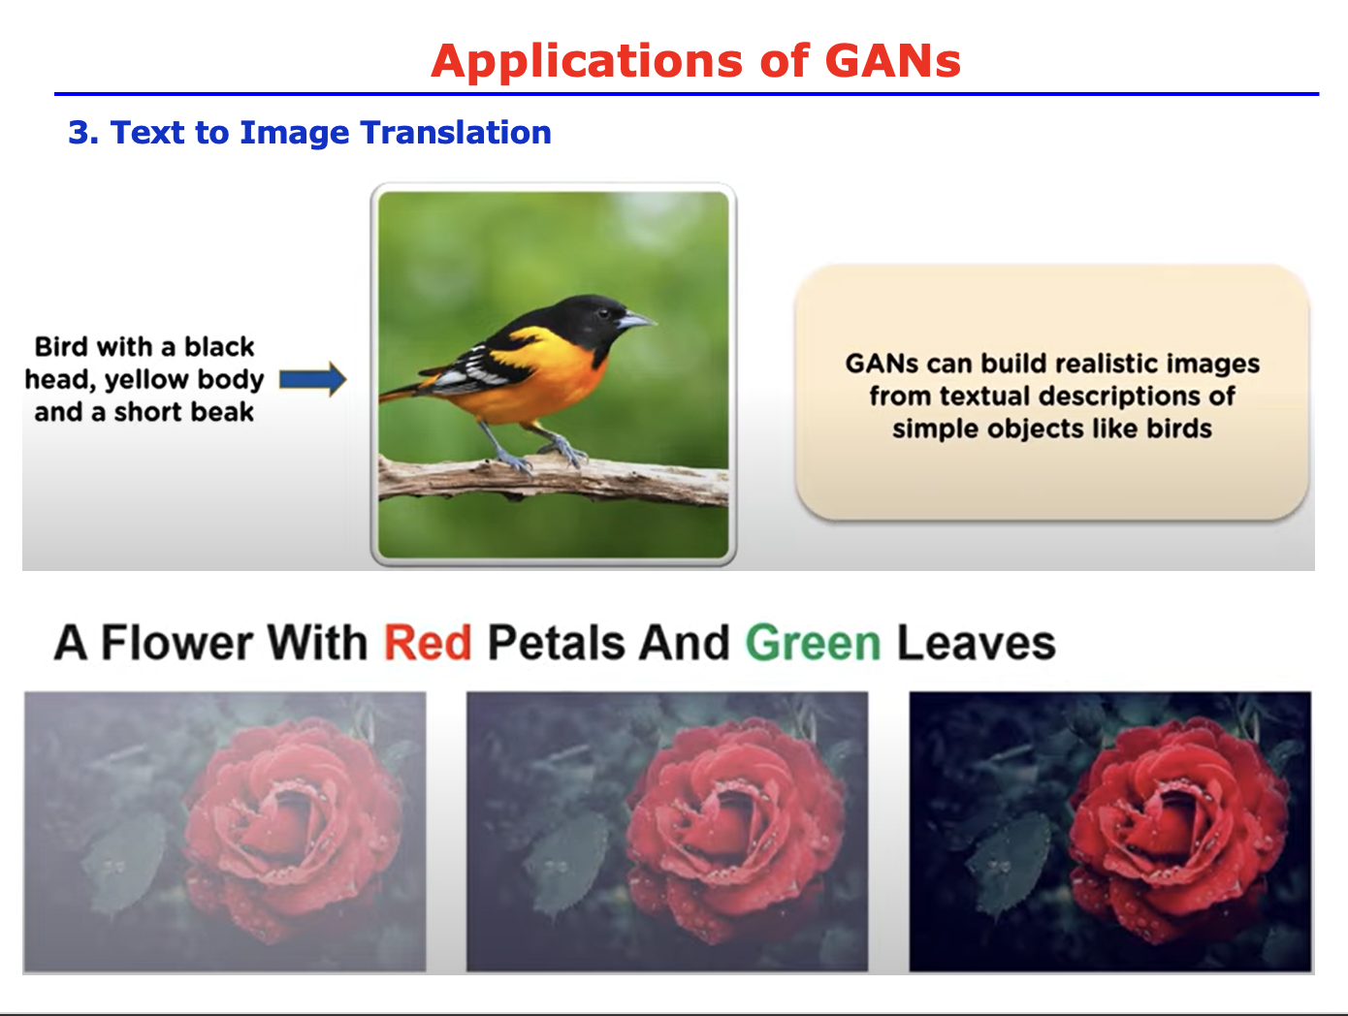

Slide 11
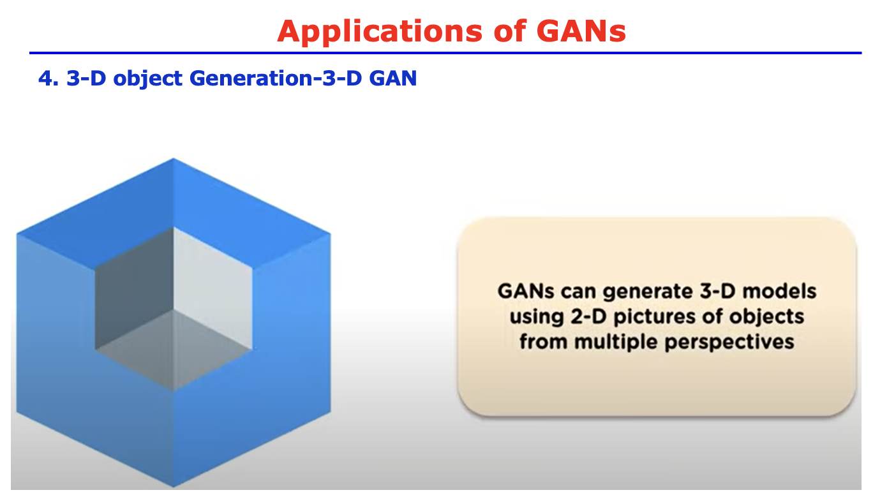

Slide 12
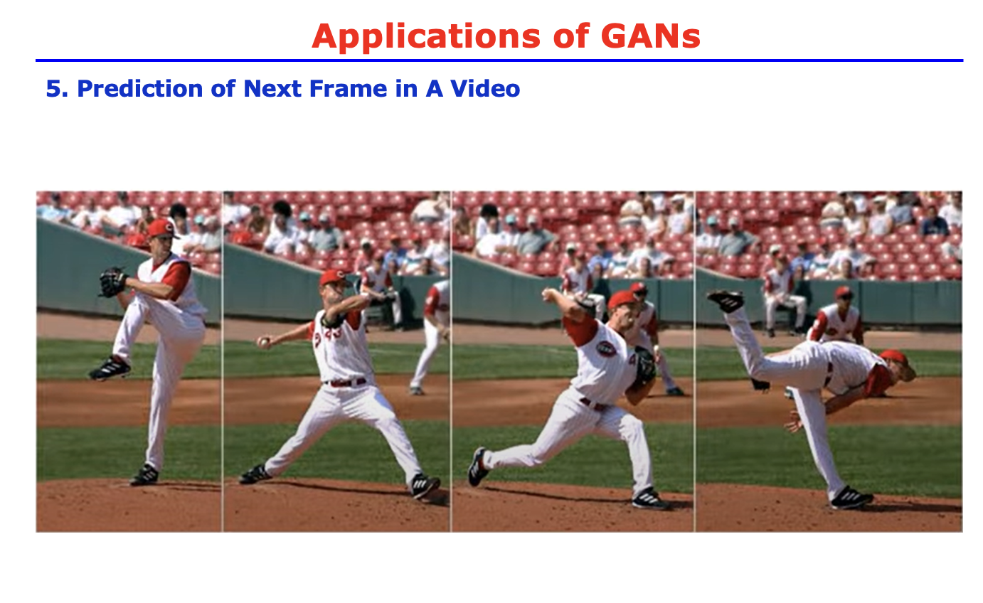

Slide 13
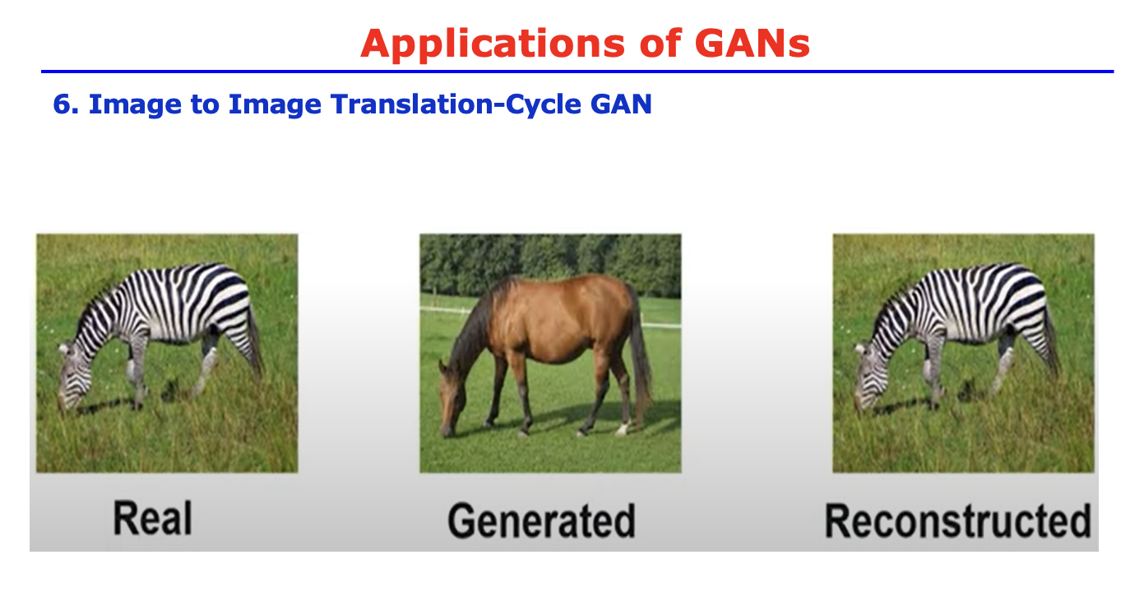

Slide 14
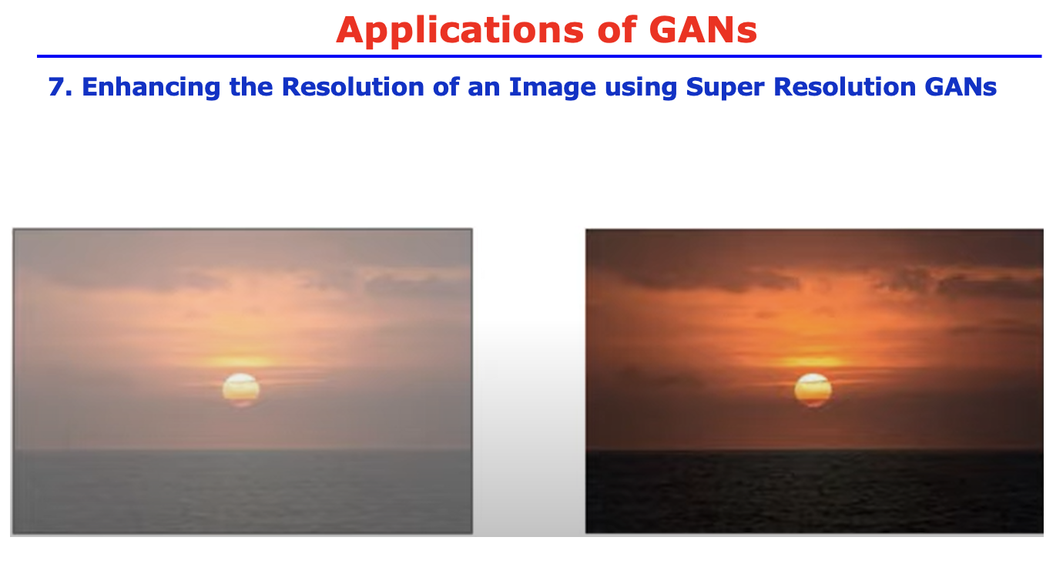

Slide 15
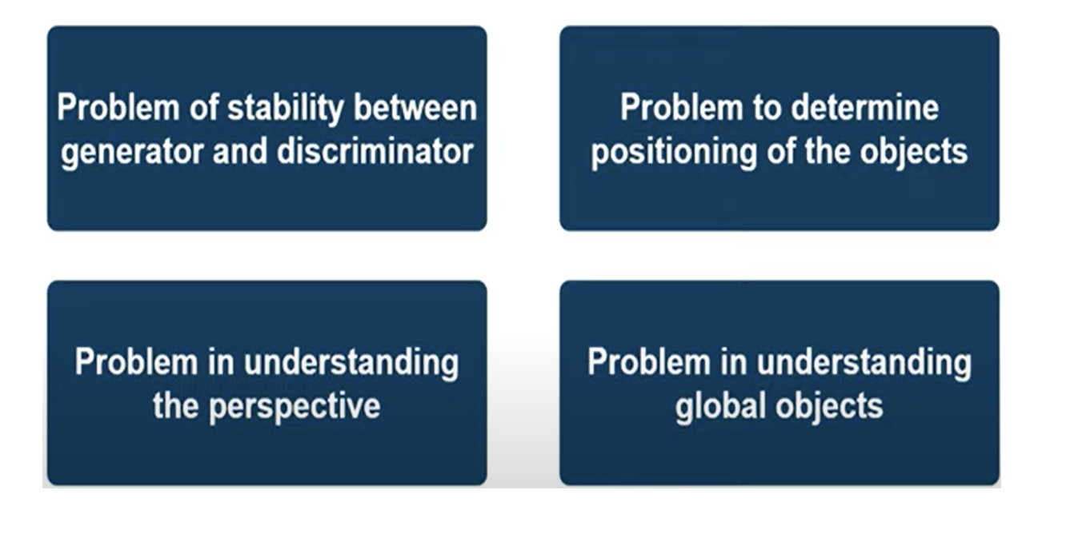
CHALLENGES FACED BY GAN

Slide 16


